Slide 1
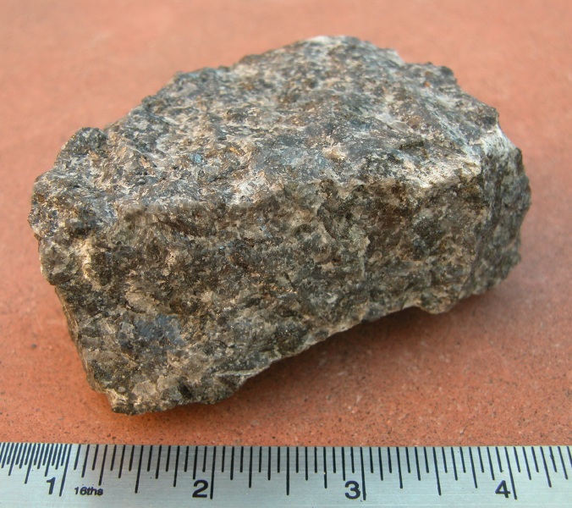
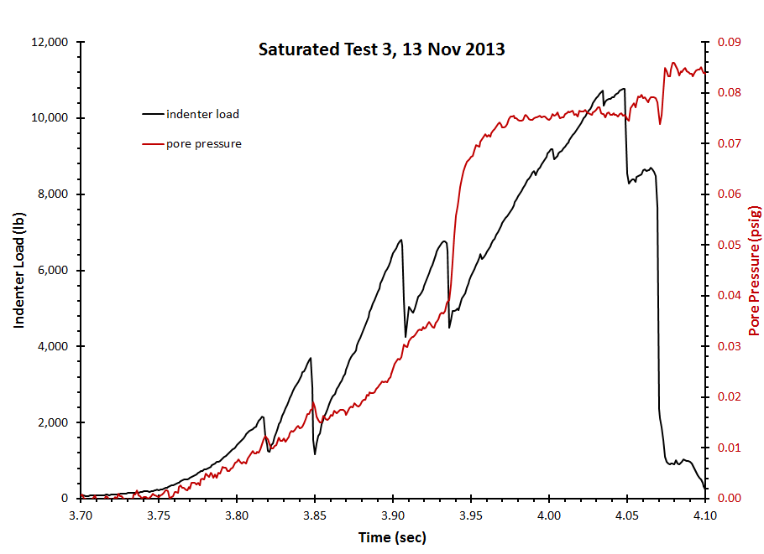
Poster Title Goes Here
Authors
Affiliations
Introduction
Materials, Methods, Procedures
Conclusions
Introduce research and goals to begin. Use bullet lists rather than text – too many words make posters hard to read.
Cite previous work where appropriate; those authors may be reading your poster.
Posters are presented differently than papers.
Change section headings and section lengths as needed.
Do not change margins or the spacings between sections.
Check spelling and grammar before printing.
Important data should be shown in charts (not tables) and placed in this larger middle column in an order such that the viewer can follow your work.
Answer these questions:
What did you do?
With what materials?
Using what techniques?
What were the results?
What do they mean?
Rules for charts:
Make all symbols, lines, and labels readable from 3 meters away.
Fully label everything that the viewer needs to understand.
Include units of measure. (Is it meters per second or furlongs per fortnight?)
Reduce text as much as possible while retaining understandability.
Make your poster self-explanatory for times when you cannot be there to explain.
Summarize findings and relate them to an overall vision (the "big picture").
Make recommendations for future work, whether your own or others.
Be sure all figures are free of distortion.
Include scales when needed for clarity.
Acknowledgements
Objectives
Thank all people and institutions who have contributed to the research.
Adjust font size based on how much content you must present.
Minimize distractions.
Maximize understanding.
Explain clearly and simply.
References
List full bibliographic information for all references cited in the poster. or important to the work When in doubt, ensure the information allows anyone to find the paper or book for themselves.
Be sure all figures have sufficient resolution . Zoom in to 100% to check this.
This chart has no labels, units, or title, though it is large enough.
Here, the font is too small and the lines are too thin.
Section categories and sizes are provided as guidelines for information that should be included. Specific titles and section length may be changed.

